Slide 1
Interactive Sense Feedback for Difficult Queries
Date: 2012/5/28
Source: Alexander Kotov. al(CIKM’11)
Advisor: Jia-ling, Koh
Speaker: Jiun Jia, Chiou

Slide 2
Outline
Introduction
Query Ambiguity
Interactive Sense Feedback
Sense Detection
Sense Presentation
Experiments
Upper-bound performance
User study
Conclusion

Slide 3
Introduction
Ambiguity of query terms is a common cause of inaccurate retrieval results.
Challenging task:
Fully automatic sense identification and disambiguation
Ambiguous queries contain one or several polysemous terms.
Birds
Sports
Clergy
Query
??
cardinals
Search
Query ambiguity is one of the main reasons for poor retrieval results
- Difficult queries are often ambiguous

Slide 4
Introduction
users submit ambiguous queries
spend some time and effort perusing search results,not realizing that the sense of a polysemous term that they had in mind is not the most common sense in the collection being searched.
Solution
Diversification
Target sense is minority sense
doesn’t help
Relevance Feedback
Top documents irrelevant
doesn’t help

Slide 5
Introduction
Can search systems improve the results for difficult queries by naturally leveraging user interaction to resolve lexical ambiguity?
Ideally, sense suggestions can be presented as clarification questions
“Did you mean <ambiguous query term> as <sense label>?”
cardinals
bird
sport
clergy
search systems can infer the collection-specific senses of query terms
Users can leverage their intelligence and world knowledge to interpret the signals from the system and make the final decision.

Slide 6
Introduction
interactive sense feedback needs to address two major problems:
Designing an efficient algorithm for automatic off-line identification of discriminative senses of query terms.
SENSE DETECTION
How to generate a representation of the discovered senses in such a way that each sense is easily interpretable and the best
sense is easily identifiable by the users.
SENSE PRESENTATION
Compare algorithms based on their upper bound retrieval performance and select the best performing one.
Propose several methods for concise representation of the discovered senses.
Evaluate the effectiveness of each method with the actual retrieval performance of user sense selections.

Slide 7
Interactive Sense Feedback
Step 1
construct a contextual term similarity matrix
Step 2
construct a query term similarity graph
Step 3
Label and present the senses to the users
Step 4
Update the query Language Model using user feedback

Slide 8
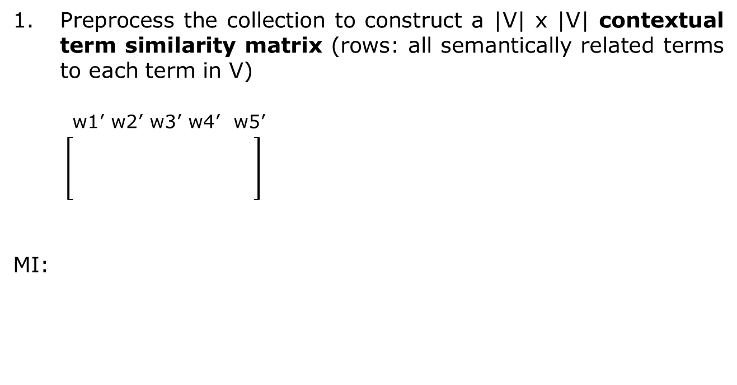
Interactive Sense Feedback
Algorithm
Preprocess the collection to construct a |V| x |V| contextual term similarity matrix (rows: all semantically related terms to each term in V)
w1’ w2’ w3’ w4’ w5’
MI:
S:sparse matrix
w1
w2
w3
S_{ij}: the strength of semantic relatedness
of the words wi and wj in a document collection C.
Mutual Information
Hyperspace Analog to Language
X_{w} and X_{v} are binary variables indicating whether w or v are present or absent in a document.

Slide 9
p(X_{w} = 1) | c(X_{w} = 1)/N
p(X_{w} = 0) | 1 − p(X_{w} = 1)
p(X_{v} = 1) | c(X_{v} = 1)/N
p(X_{v} = 0) | 1 − p(X_{v} = 1)
p(X_{w} = 1, X_{v} = 1) | c(X_{w} = 1, X_{v} = 1)/N
p(X_{w} = 1, X_{v} = 0) | [c(X_{w} = 1) − c(X_{w} = 1, X_{v} = 1)]/N
p(X_{w} = 0, X_{v} = 1) | [c(X_{v} = 1) − c(X_{w} = 1, X_{v} = 1)]/N
p(X_{w} = 0, X_{v} = 0) | 1− p(X_{w} = 1, X_{v} = 0) −p(X_{w} = 0, X_{v} = 1) − p(X_{w} = 1, X_{v} = 1)
Sum=1
Mutual information measures the strength of association between the two words and can be considered as a measure of their semantic relatedness.
Two words tend to occur in the same document,the
more semantically related they are.
MI

Slide 10
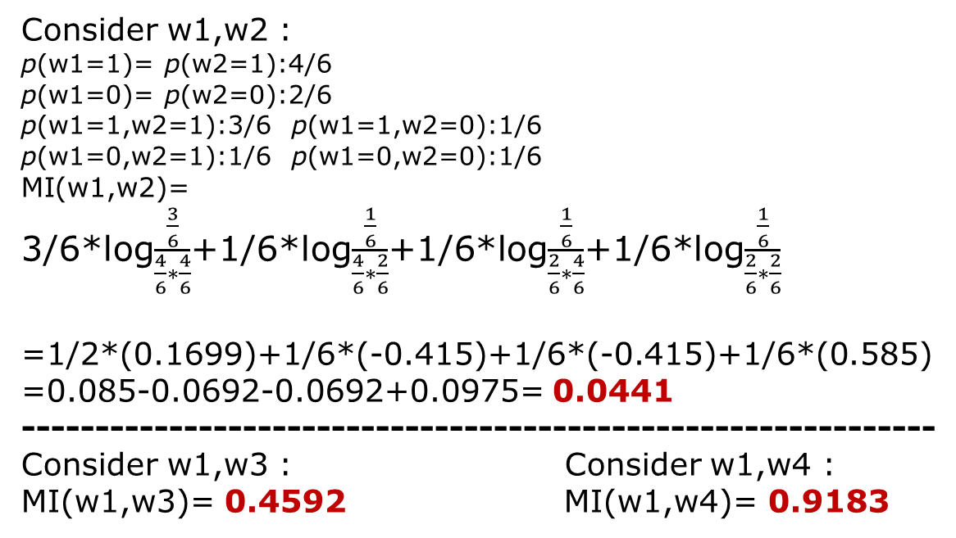
Document 1
Document 4
Word1(D1,D3,D4,D6)
Document
2
Document
5
Word2(D2,D3,D4,D6)
Word3( D1 , D3 , D6 )
Document
3
Document
6
Word4(D1,D3,D4,D6)
Consider w1,w2 :
p(w1=1)= p(w2=1):4/6
p(w1=0)= p(w2=0):2/6
p(w1=1,w2=1):3/6 p(w1=1,w2=0):1/6
p(w1=0,w2=1):1/6 p(w1=0,w2=0):1/6
MI(w1,w2)=
3/6*log$\frac{\frac{3}{6}}{\frac{4}{6}∗\frac{4}{6}}$+1/6*log$\frac{\frac{1}{6}}{\frac{4}{6}∗\frac{2}{6}}$+1/6*log$\frac{\frac{1}{6}}{\frac{2}{6}∗\frac{4}{6}}$+1/6*log$\frac{\frac{1}{6}}{\frac{2}{6}∗\frac{2}{6}}$
=1/2*(0.1699)+1/6*(-0.415)+1/6*(-0.415)+1/6*(0.585)
=0.085-0.0692-0.0692+0.0975= 0.0441
--------------------------------------------------------------
Consider w1,w3 : Consider w1,w4 :
MI(w1,w3)= 0.4592 MI(w1,w4)= 0.9183

Slide 11
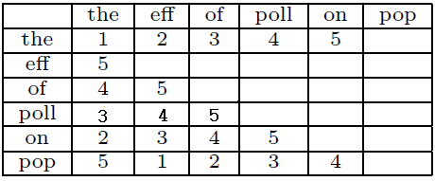
HAL(Hyperspace Analog to Language):
Constructing the HAL space for an n-term vocabulary involves traversing a sliding window of width w over each word in the corpus, ignoring punctuation, sentence and paragraph boundaries.
Slide window size=10
5 words before and after the center word
W=10
The eff of poll on the pop
HAL space matrix (H) for the sentence
“the effects of pollution on the population”
Center 5 4 3 2 1
Center 5
W=10
eff of poll on the pop
HAL space matrix for the sentence
“the effects of pollution on the population”
1 2 3 4 5 Center
11

Slide 12
Global co-occurrence matrix:
first produced by merging the row and column corresponding to each term in the HAL space matrix.
Each term t corresponds to a row in the global co-occurrence matrix H_{t} = {(t₁, c₁), . . . , (t_{m}, c_{m})}:
Number of co-occurrences of the term t with all other terms in the
vocabulary.
 | the | eff | of | poll | on | pop
the | 1 | 7 | 7 | 7 | 7 | 5
 | The | eff | of | poll | on | pop
of | 7 | 5 | 0 | 5 | 4 | 2
12

Slide 13
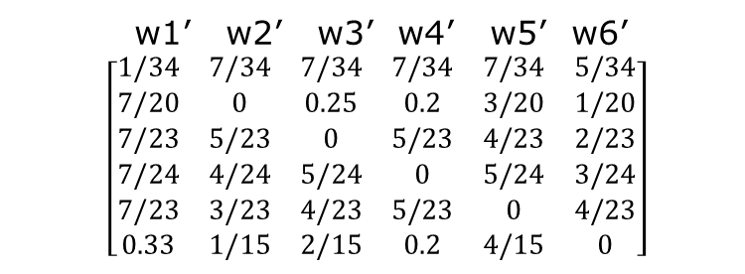
Normalized to obtain the contextual term similarity matrix for the collection:
 | the | eff | of | poll | on | pop
T1 | 1 | 7 | 7 | 7 | 7 | 5
T2 | 7 | 0 | 5 | 4 | 3 | 1
T3 | 7 | 5 | 0 | 5 | 4 | 2
T4 | 7 | 4 | 5 | 0 | 5 | 3
T5 | 7 | 3 | 4 | 5 | 0 | 4
T6 | 5 | 1 | 2 | 3 | 4 | 0
 | the | eff | of | poll | on | pop
T1 | 1/34 | 7/34 | 7/34 | 7/34 | 7/34 | 5/34
T2 | 7/20 | 0 | 5/20 | 4/20 | 3/20 | 1/20
T3 | 7/23 | 5/23 | 0 | 5/23 | 4/23 | 2/23
T4 | 7/24 | 4/24 | 5/24 | 0 | 5/24 | 3/24
T5 | 7/23 | 3/23 | 4/23 | 5/23 | 0 | 4/23
T6 | 5/15 | 1/15 | 2/15 | 3/15 | 4/15 | 0
w1’ w2’ w3’ w4’ w5’ w6’
$\left[\begin{matrix}1/34 & 7/34 & 7/34 & 7/34 & 7/34 & 5/34 \\ 7/20 & 0 & 0.25 & 0.2 & 3/20 & 1/20 \\ 7/23 & 5/23 & 0 & 5/23 & 4/23 & 2/23 \\ 7/24 & 4/24 & 5/24 & 0 & 5/24 & 3/24 \\ 7/23 & 3/23 & 4/23 & 5/23 & 0 & 4/23 \\ 0.33 & 1/15 & 2/15 & 0.2 & 4/15 & 0\end{matrix}\right]$
w1
w2
w3
w4
w5
w6
contextual term similarity matrix
13

Slide 14
Interactive Sense Feedback
Step 1
construct a contextual term similarity matrix
Step 2
construct a query term similarity graph
Step 3
Label and present the senses to the users
Step 4
Update the query Language Model using user feedback

Slide 15
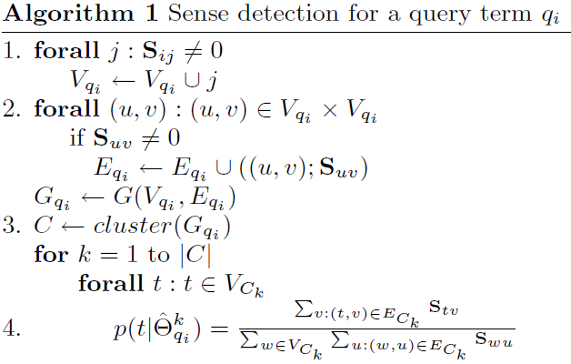

For each query term construct a query term similarity graph
Sense Detection Algorithm:
Clustering algorithms:
Community clustering (CC)
Clustering by committee (CBC)
Cluster the term graph (cluster = sense)
$$qi$$
$${\hat{Θ}}_{q}^{s_{1}}$$
$${\hat{Θ}}_{q}^{s_{2}}$$
0.25
$$w_{5}$$
$$w_{7}$$
$${\hat{Θ}}_{q}^{s_{2}}$$
p(w5| )=$\frac{0.25+0.55}{0.25+0.55+0.2}$=0.8
p(w6| )=$\frac{0.2+0.55}{0.25+0.55+0.2}$=0.75
p(w7| )=$\frac{0.2+0.25}{0.25+0.55+0.2}$=0.45
$$w_{7}$$
$$w_{5}$$
$$w_{2}$$
$$w_{1}$$
0.55
$${\hat{Θ}}_{q}^{s_{2}}$$
0.2
$${\hat{Θ}}_{q}^{s_{2}}$$
$$w_{4}$$
15
$$w_{6}$$
$$w_{3}$$
$$w_{6}$$

Slide 16
Interactive Sense Feedback
Step 1
construct a contextual term similarity matrix
Step 2
construct a query term similarity graph
Step 3
Label and present the senses to the users
Step 4
Update the query Language Model using user feedback

Slide 17
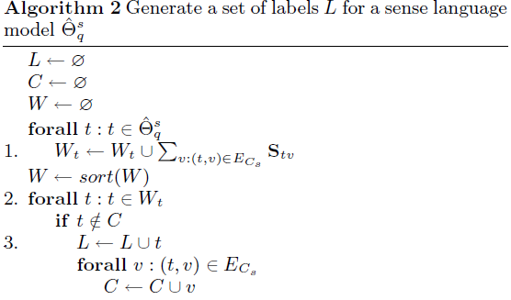
Label and present the senses to the users
─using the top k terms with the highest probability in the sense
language model
─selecting a small number of the most representative terms from
the sense language model as a sense label
Sense Presentation :
5
0.04
0.03
0.01
0.02
0.1
4
2
0.01
0.02
0.05
0.06
0.03
3
0.11
0.01
1
0.01
0.02
0.02
6
17
5
Label:
1
4
Notes:
3. Second method : uses a subgraph of the query term similarity graph, from which the sense language model was created to find a subset of terms that cover the subgraph in such a way that the sum of the weights of the vertices in the cover is maximized.

Slide 18
Interactive Sense Feedback
Step 1
construct a contextual term similarity matrix
Step 2
construct a query term similarity graph
Step 3
Label and present the senses to the users
Step 4
Update the query Language Model using user feedback

Slide 19
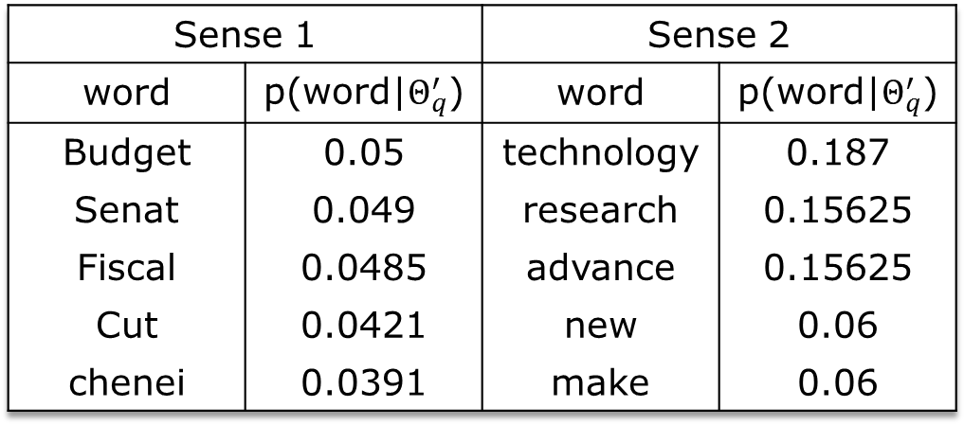
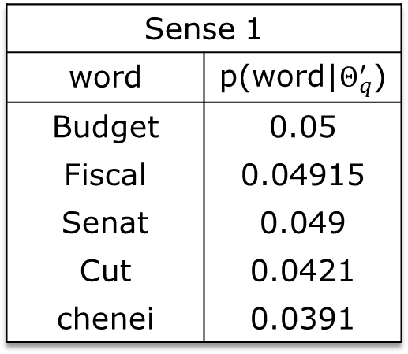
Update the query Language Model using user feedback
$$p\left(w | Θ_{q}^{′}\right)=αp\left(w | Θ_{q}\right)+\left(1−α\right)p(w|{\hat{Θ}}_{qi}^{s_{}})$$
If $α$=0.9
Sense 1 |  | Sense 2
word | p(word|$Θ_{q}^{′}$) | word | p(word|$Θ_{q}^{′}$)
Budget | 0.05 | technology | 0.187
Senat | 0.049 | research | 0.15625
Fiscal | 0.0485 | advance | 0.15625
Cut | 0.0421 | new | 0.06
chenei | 0.0391 | make | 0.06
User
w1
w2
w3
w4
w5
Select “Fiscal”
Sense 1
word | p(word|$Θ_{q}^{′}$)
Budget | 0.05
Fiscal | 0.04915
Senat | 0.049
Cut | 0.0421
chenei | 0.0391
p(Fiscal|$Θ_{q}^{′}$)=0.9*0.0485+(1-0.9)* $p(w|{\hat{Θ}}_{qi}^{s_{}})$
= 0.04915
0.055
19

Slide 20
KL-divergence retrieval model
increase
KL value:
increase
θ_{q} :query language model
θ_{Di} : document language model
each document D_{i} in the document collection C = {D₁ , . . . , D_{m}}.
A B C D Θq
(2) (3) (2) (3) query
A B C D E ΘD
(2) (2) (1) (3) (2) document
A: 0.2*log(0.2/0.2)=0
B : 0.3*log(0.3/0.2)=0.1755
C : 0.2*log(0.2/0.1)=0.2 D_{KL} =0.3755
D: 0.3*log(0.3/0.3)=0
E : 0
20

Slide 21
Experiments
Datasets: 3 TREC collections
Upper bound experiments:
try all detected senses for all query terms and study the potential of using sense feedback for improving retrieval results.
User study:
present the labeled sense to the users and see whether users can recognize the best-performing sense; determine the retrieval performance of user selected senses.
21
Notes:
The TREC topics 51-150 for the AP88-89 collection are long, sentence-like queries, including on average more than 3 query terms. The TREC topics 301-450 and 601-700 for the ROBUST04 collection are mostly 2-3 term queries with a small number of highly ambiguous one term queries (e.g, metabolism, robotics, tourism, creativity).
The AQUAINT topics include 50 topics, known to be hard (i.e. resulting in very low retrieval performance) from the previous Robust
tacks.

Slide 22
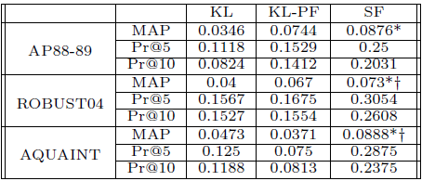
Upper-bound performance
(for difficult topics)
* indicates statistically significant difference relative
to KL (95% confidence level), according to the
Wilcoxon signed-rank test.
† indicates statistically significant difference relative to KL-PF (95% confidence level), according to the Wilcoxon signed-rank test.
22

Slide 23
 | Total | Diff | Norm | PF |  | SF
 |  |  |  | Diff+ | Norm+ | Diff+ | Norm+
AP | 99 | 34 | 64 | 19 | 44 | 31 | 37
ROBUST04 | 249 | 74 | 175 | 37 | 89 | 68 | 153
AQUAINT | 50 | 16 | 34 | 4 | 26 | 12 | 29
Sense feedback improved more difficult queries than Pseudo feedback(PF) in all datasets
23

Slide 24
Upper-bound performance
Community Clustering (CC) outperforms Clustering by Committee (CBC)
HAL scores are more effective than Mutual Information (MI)
Sense Feedback performs better than PF on difficult query sets
24
Notes:
All feedback methods are evaluated based on their ranking of the top 1000 documents with respect to the mean average (non-interpolated) precision (MAP), precision at top 5 and 20 documents (Pr@5 and Pr@20) and the total number of relevant documents retrieved (RR).

Slide 25
Sample senses discovered by using the community clustering algorithm
in combination with the HAL scores:
senses discovered for the term “cancer” in the query “radio waves and brain cancer”
cancer research
different
types of cancer
cancer treatment
cancer statistics in the US
25

Slide 26
User study
50 AQUAINT queries along with senses determined using CC and HAL
Senses presented as:
1, 2, 3 sense label terms using the labeling algorithm (LAB1, LAB2, LAB 3)
3 and 10 terms with the highest score from the sense language model (SLM3, SLM10)
From all senses of all query terms users were asked to pick one sense using each of the sense presentation method
$${\hat{Θ}}_{q}^{s_{}}$$
p(term| )
26

Slide 27
User study
Percentage of users selecting the optimal sense of the optimal term for sense feedback (in boldface) and the optimal term, but suboptimal sense (in parenthesis).
Users selected the optimal query term for disambiguation for more than half of the queries
27
Notes:
1. Users do not tend to select the best sense more often when they observe more terms both in the label and the sense language model. One-term label is often sufficient to recognize the best sense and adding more terms can potentially mislead and confuse the user.

Slide 28
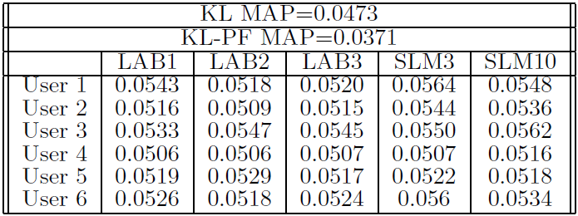
User study
(0.2286)
Users sense selections do not achieve the upper bound, but consistently improve over the baselines
28

Slide 29
Conclusion
Interactive sense feedback as a new alternative feedback method
Proposed methods for sense detection and representation that are effective for both normal and difficult queries
Promising upper bound performance all collections
User studies demonstrated that
users can recognize the best-performing sense in over 50% of the cases
user-selected senses can effectively improve retrieval performance for difficult queries
29

Slide 30
Thank you
for your Attention !
END
30

Slide 31
Supplementary material
Mean Average Precision (mAP)
R_{q1}={d₃,d₅₆, d₁₂₉}
Three relevant documents
ranked at 3, 8, 15
Precisions are 1/3 , 2/8 , 3/15
Average Precision=(0.33+0.25+0.2)/3
=0.26
R_{q2}={d₃, d₉, d₂₅ ,d₅₆ ,d₁₂₃}
Three relevant documents
ranked at 3, 8, 15
Precisions are 1/1,2/3,3/6,4/10,5/15
Average Precision=
(1+0.67+0.5+0.4+0.33)/5=0.58
MAP=(0.26+0.58)/2=0.42
31

